Slide 1
Hyperparameters for RL
Neural nets architectures
  Number of layers
  Number of nodes
  Layers connections
  Activation functions
Dropout & associated HPs
Optimizers (Adam, RMSprop...)
& associated HPs
Learning rates
Loss functions
Neural nets initialization
Discount
Reward Rescaling
Experience Replay
& associated HPs (prio...)
Regularizers & associated Hps
Batch size
Algorithm choice
& algorithm – specific HPs

Slide 2
HP Search on Taxi-v3
- Random Search
- Coarse to Fine
- Bayesian approach

Slide 3
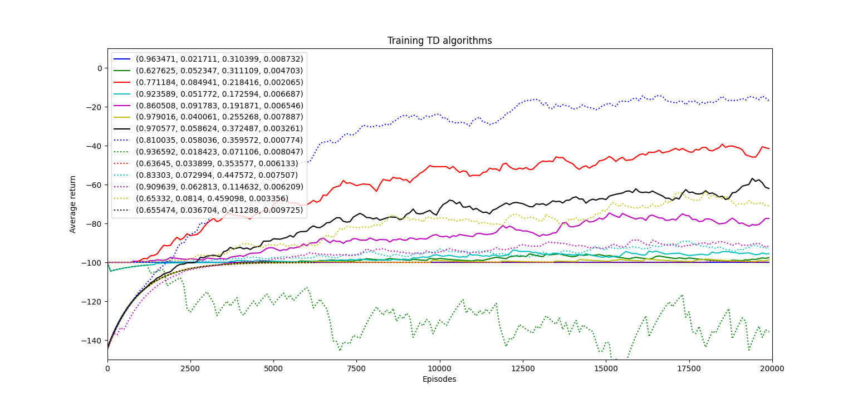
Random Search on Q-Learning
Setting Discount, Step Size, Exploration rate, Step Size Decay Rate
First try :
  Initial ranges : [0.6,1],[0.001,0.1],[0,0.5],[0,0.01]

Slide 4
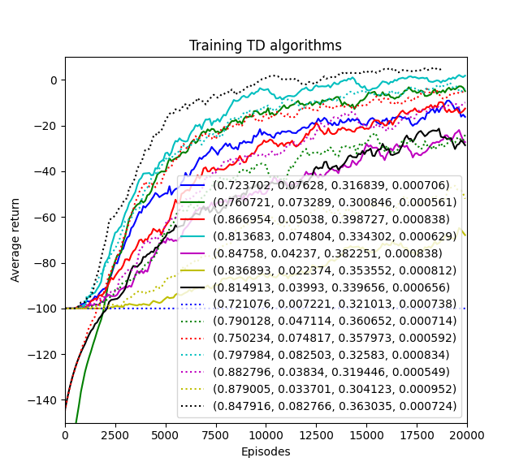
Random Search on Q-Learning
Setting Discount, Step Size, Exploration rate, Step Size Decay Rate
Second try : centering the range around the best previous result
  Ranges : [0.7,0.9], [0.001,0.1], [0.3,0.4], [0.0005,0.001]

Slide 5
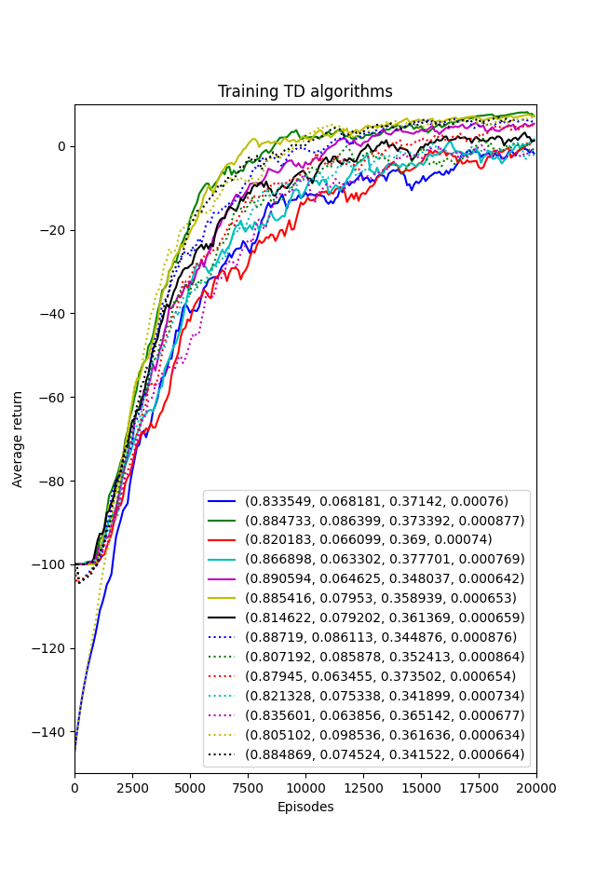
Random Search on Q-Learning
Setting Discount, Step Size, Exploration rate, Step Size Decay Rate
Third try : centering the range around the best previous result
  Ranges : [0.8,0.9], [0.06,0.1], [0.34,0.38], [0.0006,0.0009]

Slide 6
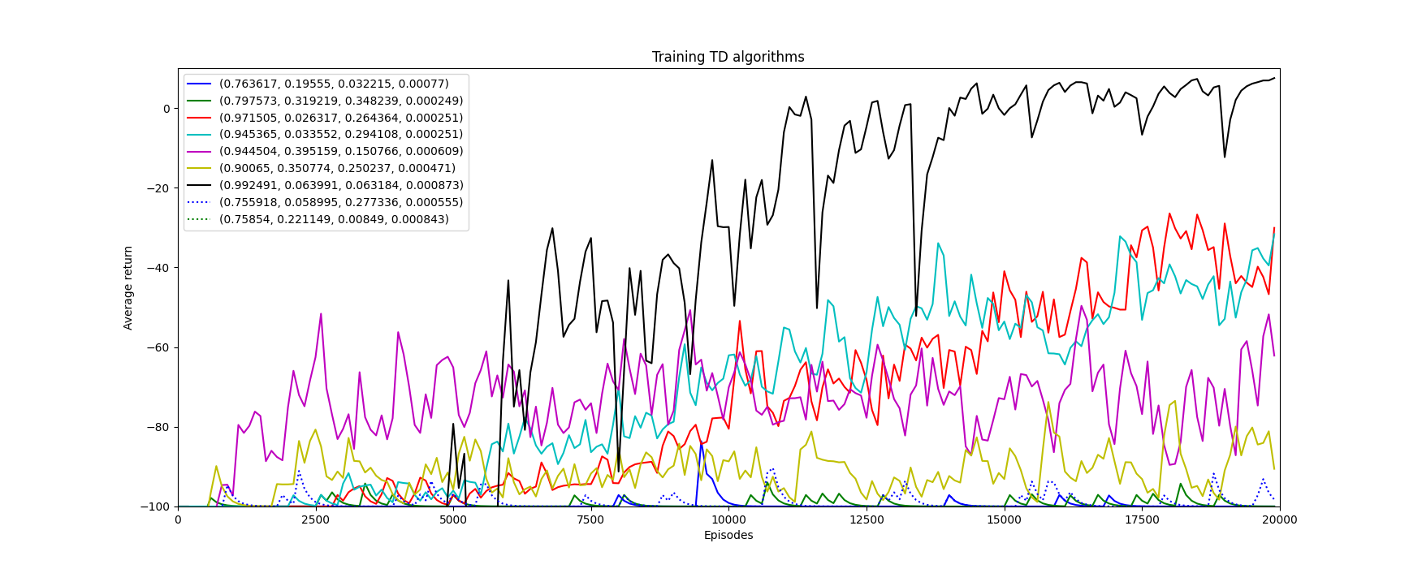
Random Search on SARSA
To try and find a HP combination for which the algorithm converges – it actually can

Slide 7
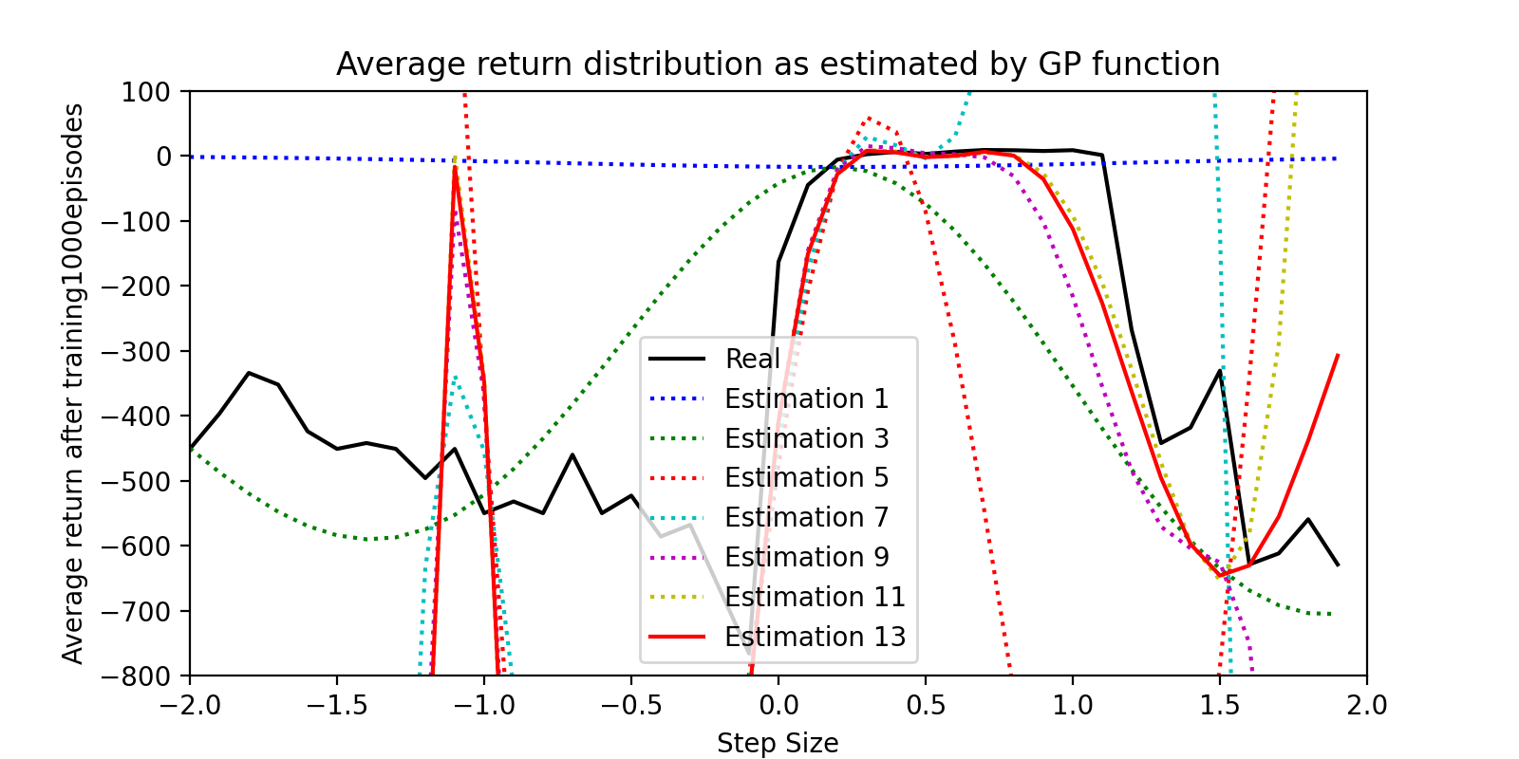
Bayes Search
Fixing every parameter to good values except the step size
  Bayes search algorithm has to approximate the “cost function” of the step size to find its optimum
  Uses a Gaussian Process Regressor

Slide 8
Bayes Search
Using Bayes search to tune the hyperparameters from scratch (wide initial range)
Comparing with Random Search
  Bayes is better with a low number of samples
  Random is more parallelizable !

Slide 9
Other methods
Manual tuning (...)
Evolutionary methods seem too expensive
BOHB (combines HyperBand & Bayes Opt)
See https://arxiv.org/pdf/2201.03916.pdf
(AutoRL survey)

Slide 10
Other notes
A non-stationary optimization problems
  Hps may need to evolve during the learning process for better results
  Especially since the data distribution evolves (RL-specific)
DRL that matters https://arxiv.org/abs/1709.06560
Implementation details matter https://arxiv.org/pdf/2005.12729.pdf

